Slide 1

CARDIO GOOD FITNESS
Market Analysis of Company’s Treadmill Products

Slide 2
TABLE OF CONTENTS
04
Applications
05
Data
Trends
Conclusions
06
Key Findings
01
You could describe the
topic of the section here
You could describe the
topic of the section here
Demographics
02
You could describe the
topic of the section here
You could describe the
topic of the section here
03
You could describe the
topic of the section here
You could describe the
topic of the section here

Slide 3

INTRODUCTION
This market analysis attempts to help sales representatives distinguish the best-fit product for each potential customer based on historical data. The data has been analyzed for trends and used to create Customer Profiles. Each profile strives to predict buying behaviours of specific demographics based on the identified trends.

Slide 4

Assumptions
Assumption #1
First, it is assumed that the TM195 is the lower-end brand in terms of both quality and price, the TM498 is the medium-end, and the TM798 is the higher-end brand. This means that the higher the brand number, the superior its features, durability and desirability, thus the higher price tag.

Slide 5
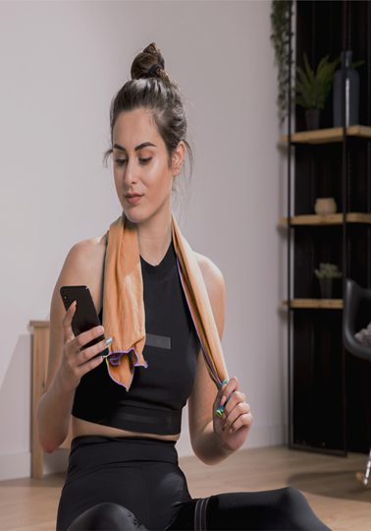
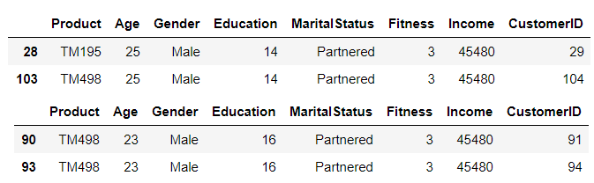
Assumptions
Assumption #2
Second, despite the fact that there are 180 distinct product sales, it can be assumed that there are only 178 distinct customers. Shown below are a pair of presumed duplicates. It seems more probable that the same individual made two purchases than that there are two individuals of the same age, gender, education, marital status, fitness and income. Note: usage and miles were excluded because they are product dependent, not customer dependent. Therefore, the duplicate entries (103 and 93) were INCLUDED in product analysis but EXCLUDED from Customer Profiles.

Slide 6
01
Key Findings

Slide 7
Primary Indicators
Generally speaking, as any one of these variables increases, the likelihood that a customer purchases a higher-end model also increases. In most cases, when more than one of these variables increases, the effects are compounded.
TM798
Fitness: people with high fitness levels almost unanimously
choose the TM798
Income: lower income customers choose the TM195 more
than any other brand.
TM498
Miles: loggers of medium to low miles purchase the TM195,
the TM498 and the TM798 in almost a 3:2:0 ratio.
Usage: while there is a 5:4 split amongst low users (TM195 to
TM498), high users ONLY purchase the TM798
TM195
Education: people with high fitness levels almost unanimously
choose the TM798
High Medium Low

Slide 8
Secondary Indicators
Generally speaking, Gender did not play as big of a role in predicting which model a customer was most likely to buy. There is almost moderate, positive correlation between males and TM798; a weak negative correlation between males and TM498; and, an even weaker negative correlation between males and TM195. The opposite is true for females.
TM798
TM498
Gender: gender should only be used in conjunction with the
primary indicators to help predict brand selection. For
example, while male, Gen Zers who have graduated
from college are about equally likely to choose a
TM498 model as a TM798, their female counterparts
unanimously choose the lower, TM498.
TM195
Males Females

Slide 9
Tertiary Indicators
Generally speaking, Age and Marital Status did not have any affect on the choice of product. Both of these indicators had almost zero correlation with any of the three brands. This means that they should not be used to help select which model should be marketed to a customer, but they may be used to build richer Customer Profiles.
TM798
Age: age is not a helpful indicator on its own, but coupled
with other variables, such as Gender. For example, for
males aged 41-50 (Gen X) there is an almost even
distribution between TM195, TM498 and TM798 (3:2:4),
however, for females in this age group, they
unanimously selected the TM195.
TM498
Marital
Status: marital status has perhaps the weakest correlation with all
three products. Gen Z is one of the only demographics where
marital status affects product decisions. Singles choose the
TM195 and TM498 almost equally, while a partnered male is
twice as likely to choose the TM498 and the partnered female
is twice as likely to pick the TM195.
TM195
Age Marital Status

Slide 10
Top |ndicators by Product
PREMIUM
BASIC
TM798
STANDARD
TM195
TM498
Fitness
Income
Miles
Usage
Education
Fitness
Income
Miles
Usage
Education
Fitness
Income
Miles
Usage
Education
High Medium Low

Slide 11
02
Demographics

Slide 12
180
Number of distinct product sales across all three product lines

Slide 13
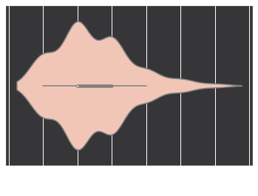
Product
Usage is based on the number of days per week an individual workouts out on their treadmill:
TM195: n = 80
TM498: n = 60
TM798: n = 40
44.4%
33.3%
22.2%
TM195
TM498
TM798

Slide 14
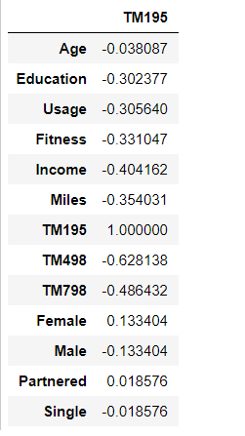
Product: TM195
Key Relationships
Implications
Income
Miles
Fitness
Usage
Education
There is an moderate inverse relationship between the TM195 product and Customers’ Income, Fitness and Education. This means that people with lower scores in these areas are more likely to buy the TM195. People who use treadmills less often and log few miles are also more likely to purchase the TM195. There is also a weak correlation between gender and TM195, with Females slightly more likely to buy it and males slightly less likely.
Negative
Positive
-1 -.6 -.3 -.1 0 .1 .3 .6 1
Strong Moderate Weak None Weak Moderate Strong

Slide 15
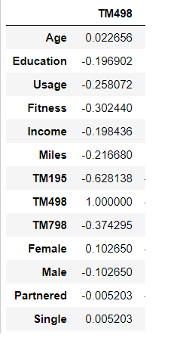
Product: TM498
Key Relationships
Implications
Fitness
The only key relationship that exists is a negative correlation between TM498 and Fitness. This means that as fitness goes up, the customer is less likely to purchase this model. However, other factors such as Usage, Miles, Income, Education and Gender are weakly correlated. This makes sense because this product is in the middle tier. Individuals with lower scores in these categories tend to purchase the TM195 and individuals with higher scores, the TM798.
Negative
Positive
-1 -.6 -.3 -.1 0 .1 .3 .6 1
Strong Moderate Weak None Weak Moderate Strong

Slide 16
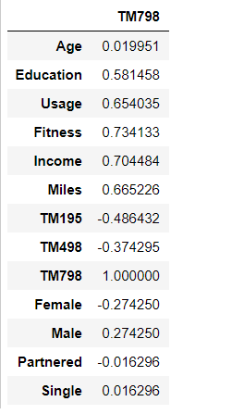
Product: TM798
Key Relationships
Implications
Fitness
Income
Miles
Usage
Education
There is a strong relationship between the TM798 and Fitness, Income, Miles and Usage. This means that as these values increase, it is more likely that the customer will purchase the TM798. Education is very close to the threshold of r = 0.6 and could also be considered strongly correlated. There is a moderate positive correlation between Males and the TM798, while Females are less likely to buy this product.*
* r = 0.27 is close to the 0.3 ‘moderate’ threshold
Negative
Positive
-1 -.6 -.3 -.1 0 .1 .3 .6 1
Strong Moderate Weak None Weak Moderate Strong

Slide 17
Usage
Usage is based on the number of days per week an individual workouts out on their treadmill:
0 days/week: n = 0
1 day/week: n = 0
2 days/week: n = 33
3 days/week: n = 69
4 days/week: n = 52
5 days/week: n = 17
6days/week: n = 7
7 days/week: n = 2
18.3%
37.8%
28.3%
9.4%
3.9%
1.1%
2 days
3 days
4 days
5 days
6 days
7 days

Slide 18
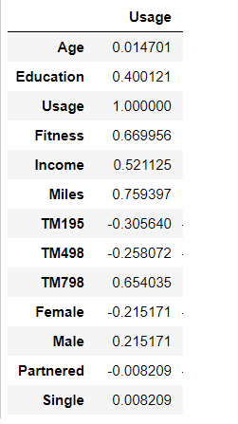
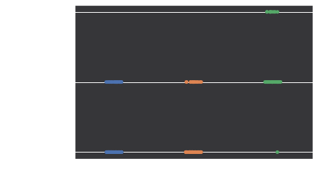
Usage as a Sales Criteria
There is a very strong positive correlation between Usage and the TM798. We can recategorize the Usage data so that 0 – 3 days per week is Low Usage, 4-5 days per week is Medium Usage and 6-7 days per week is High Usage. The chart below shows that High Usage customers almost always purchase the TM798, while Low Usage customers prefer the TM195 or TM498 models. Asking the customer how often (s)he plans on using the machine per week will give the sales representative a good indication of which model to present.
Negative
Positive
-1 -.6 -.3 -.1 0 .1 .3 .6 1
Strong Moderate Weak None Weak Moderate Strong
Hot Sales Tip:
Promote TM798 amongst Medium and High Usage Runners!

Slide 19
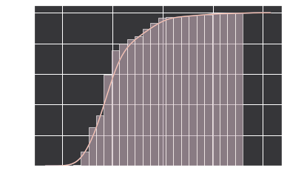
Miles
Miles is based on the number of miles the individual is planning on logging on the treadmill:
Low : 21 miles to 66 miles (n = 46)
Medium: 67 miles to 94 miles (n = 61)
Medium-High: 95 miles to 115 miles (n = 28)
High: 116 miles to 360 miles (n = 45)
25.6%
38.9%
15.6%
25.0%
Low
Medium
Med-High
High

Slide 20
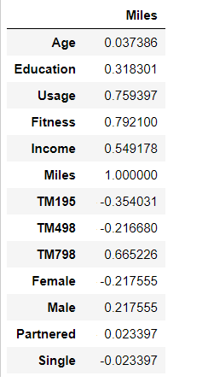
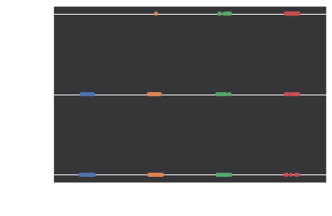
Miles as a Sales Criteria
There is a very strong positive correlation between Miles and the TM798. Like the Usage data, we can recategorize expected miles into buckets: < 67 miles = Low, 67 to 95 miles = Medium, 95 to 113 miles = Med-High and > 113 miles = High. While it is more likely that customer who expect to fall into the High category will purchase a TM798 and customers who fall into the Low will almost never purchase the TM798, people in all buckets will purchase the TM195 and TM498. Therefore, it is best to use Miles as a guideline only or in conjunction with other sales variables.
Negative
Positive
-1 -.6 -.3 -.1 0 .1 .3 .6 1
Strong Moderate Weak None Weak Moderate Strong
Hot Sales Tip:
Planning on 100+ miles?! Definitely promote the TM798!

Slide 21
178
Number of distinct customers across all demographics

Slide 22
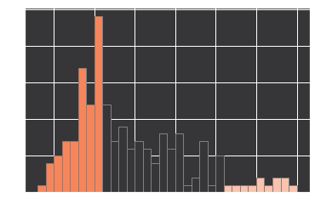
Age
6.7%
Gen X
50.0%
43.3%
Gen Y
Gen Z
Customers were placed in buckets based on age:
Gen Z – 18 to 25 (n = 77)
Gen Y – 26 to 40 (n = 89)
Gen X – 41 -50 (n = 77)

Slide 23
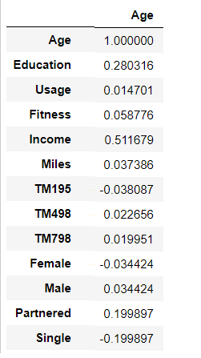
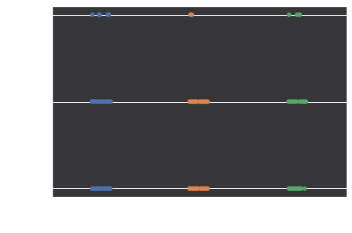
Age as a Sales Criteria
Statistically, there is almost no correlation between age and any of the three products. This means it is just as likely that an individual of any age level will purchase any of the three products with equal frequency. The positive correlations present do show that as age goes up, their income, education and likeliness to be partnered also goes up. By itself, age is not a good predictor of product. These relationships will be more important for customer profiling than direct product targeting.
Negative
Positive
-1 -.6 -.3 -.1 0 .1 .3 .6 1
Strong Moderate Weak None Weak Moderate Strong

Slide 24
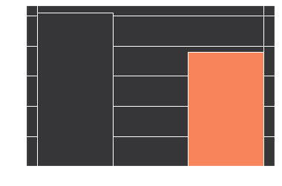
Gender
57.3%
Males
42.7%
Females
There were 102 male customers and 76 female customers.

Slide 25
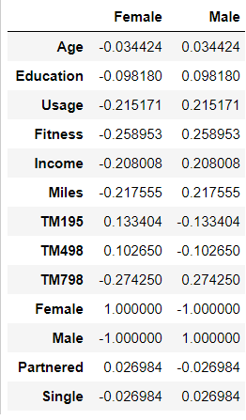

Gender as a Sales Criteria
There is a weak (almost moderate) correlation between Gender and TM798. This product is slightly more preferred by Males and slightly less preferred by Females. Gender should not be used in isolation to recommend a particular product to customers. The weak positive correlations between Males and Usage, Fitness, Income and Miles may help in constructing Customer Profiles. As the correlation table suggests, there are fewer women customers of TM798 showing in the frequency chart below.
Negative
Positive
-1 -.6 -.3 -.1 0 .1 .3 .6 1
Strong Moderate Weak None Weak Moderate Strong

Slide 26
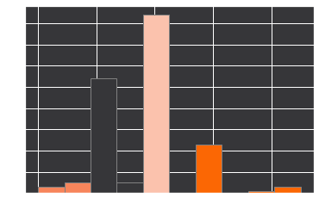
Education
15.2%
Post Grad
4.5%
High School
47.2%
College Grad
33.1%
Some College
Four distinct educational groups were created:
High School, n = 8 (12 to 13 years)
Some College, n = 59 (14 to 15 years)
College Grads, n = 84 (16 years)
Post Grads, n = 27 (17 to 21 years)

Slide 27
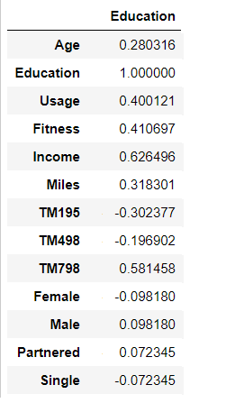

Education as a Sales Criteria
There is a weak (almost moderate) correlation between Gender and TM798. This product is slightly more preferred by Males and slightly less preferred by Females. Gender should not be used in isolation to recommend a particular product to customers. The weak positive correlations between Males and Usage, Fitness, Income and Miles may help in constructing Customer Profiles. As the correlation table suggests, there are fewer women customers of TM798 showing in the frequency chart below.
Negative
Positive
-1 -.6 -.3 -.1 0 .1 .3 .6 1
Strong Moderate Weak None Weak Moderate Strong
Hot Sales Tip:
Post Grads love TM798; High School Grads prefer TM195

Slide 28
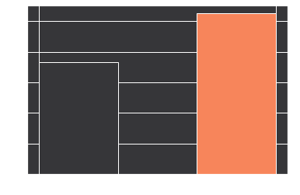
Marital Status
41.1%
Single
58.9%
Partnered
There were 105 partnered customers and 73 single customers.

Slide 29
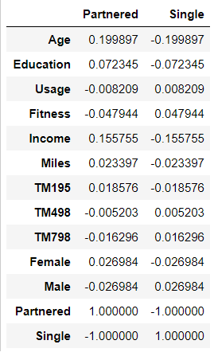

Marital Status as a Sales Criteria
Marital has no visible correlations with any of the three products. There is a weak relationship between Marital Status and Age and Marital Status and Income. This seems appropriate since many individuals are waiting to get married. However, it means that this is not a good indicator to help predict the sale of the different products.
Negative
Positive
-1 -.6 -.3 -.1 0 .1 .3 .6 1
Strong Moderate Weak None Weak Moderate Strong

Slide 30
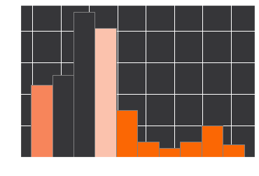
Income
25.3%
Low Income
28.1%
Middle Income
25.3%
Upper Income
21.3%
Upper/Middle Income
Income was divided into four categories:
Low Income (n = 45)
Middle Income (n = 50)
Upper/Middle Income (n = 45)
Upper Income (n = 38)
Notes:
Fig. 1 – The histogram generated by matplotlib in python shows that dispersion of annual income in USD broken into the 4 quadrilles:
Q1 (25%) ranges from $29,562 (minimum) to $43,490.25
Q2 (50%) ranges from $43,490.26 to $51,165.00
Q3 (75%) ranges from $51,165.01 to $58,972.00

Slide 31
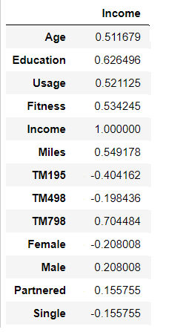

Income as a Sales Criteria
Income is strongly correlated with the TM798, it also has a weak negative correlation with TM498 and a moderately negative correlation with TM195. This means that individuals in lower income brackets are much more likely to purchase the TM195 and individuals in high income brackets strongly prefer the TM798. The frequency graph below shows that no low income individuals can afford the TM798, while many upper income individuals still purchase the TM195.
Negative
Positive
-1 -.6 -.3 -.1 0 .1 .3 .6 1
Strong Moderate Weak None Weak Moderate Strong
Hot Sales Tip:
Find out the customer’s income and market appropriately! High & Upper/Middle: TM798; Middle: TM498; Low: TM196

Slide 32
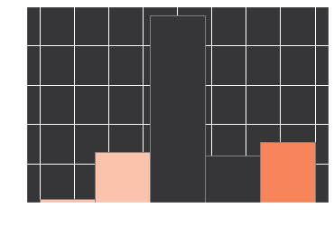
Fitness
15.7%
Low Fitness
30.1%
High Fitness
53.4%
Medium Fitness
Income was divided into four categories:
Low Income (n = 45)
Middle Income (n = 50)
Upper/Middle Income (n = 45)
Upper Income (n = 38)
Notes:
Fig. 1 – The histogram generated by matplotlib in python shows that dispersion of annual income in USD broken into the 4 quadrilles:
Q1 (25%) ranges from $29,562 (minimum) to $43,490.25
Q2 (50%) ranges from $43,490.26 to $51,165.00
Q3 (75%) ranges from $51,165.01 to $58,972.00

Slide 33
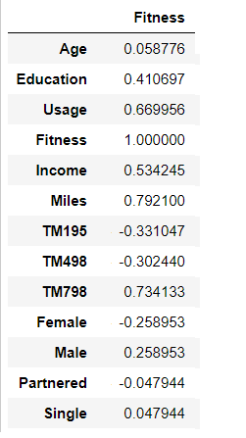

Fitness as a Sales Criteria
The correlation table shows a strong positive relationship between Fitness and the TM798 model. As fitness levels go up, individuals are more willing to invest in a superior machine. Conversely, individuals with lower fitness levels are more prone to purchase the lower- or mid-level product. There is also strong positive relationships between Fitness and Usage and Fitness and Miles. Weaker correlations between Fitness and Education, Income and Gender may assist with creating Customer Profiles.
Negative
Positive
-1 -.6 -.3 -.1 0 .1 .3 .6 1
Strong Moderate Weak None Weak Moderate Strong

Slide 34
03
Trends

Slide 35
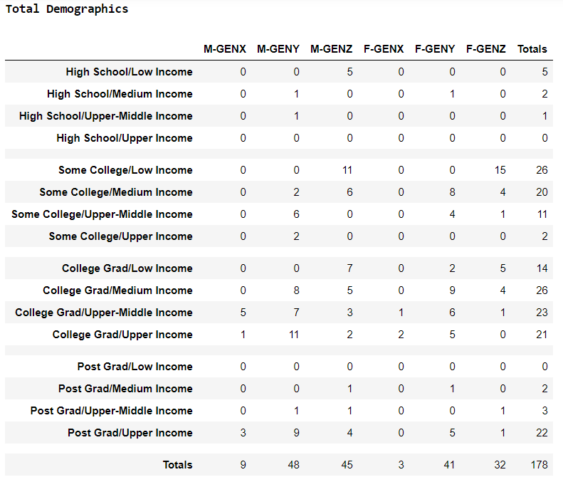
Customer Demographics
The table to the left shows all Customers (178) grouped by sex (M = male, F = Female) and Age (Gen Z = 18-25, Gen Y = 26-40, Gen X = 41-50). They customers are broken into groups based on Education and Income.
The purpose of this table is to identify trends based on age, sex, education and income.
The orange circles identify individual groups where
the sample group is > 5% of the total sample size (5% =
8.9)
The pink ovals identify groups based on gender and age
who may have similarities despite belonging to
different income brackets or have different education
levels.
The dark grey ovals identify groups based on education
and income who may have similarities despite
belonging to different genders or age groups.

Slide 36
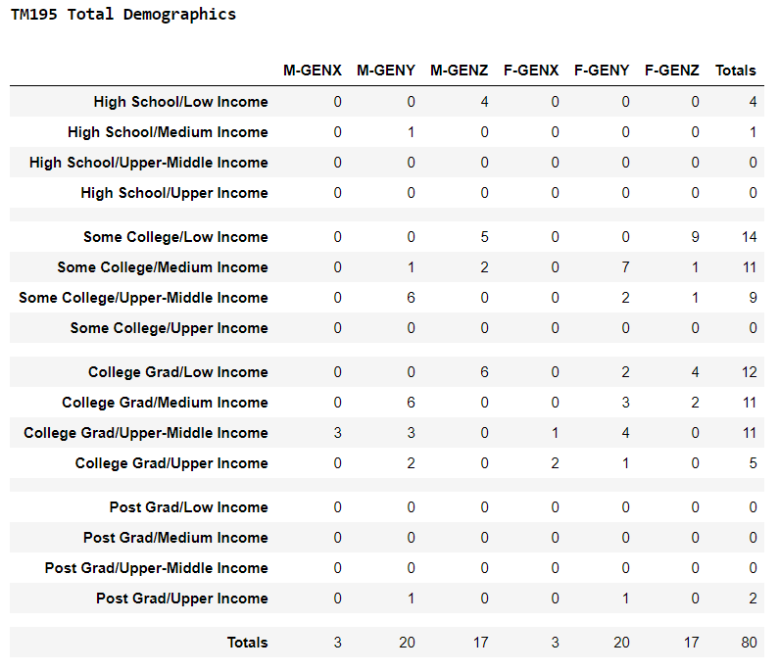
TM195 Demographics
The table to the right shows all Customers who purchased the TM195 product from the total sales sample (n = 180). The table shows very few TM195s were sold to people with post-graduate education or with high incomes.
There is a relatively high number of Male, Gen Z
customers with low incomes and high school
education who purchased the TM195. Two other
seemingly stand-alone groups include: Gen-Z, males,
low income, college grads; and, Gen-Z, females, low
income, some college.
There are a number of age groups that could be
considered together: Gen Y, males and females, some
college/college grads, medium to upper/middle
income.
Two cross-generational groups appear to stand out:
Upper/Middle income college grads, and medium
-income individuals with some college education

Slide 37
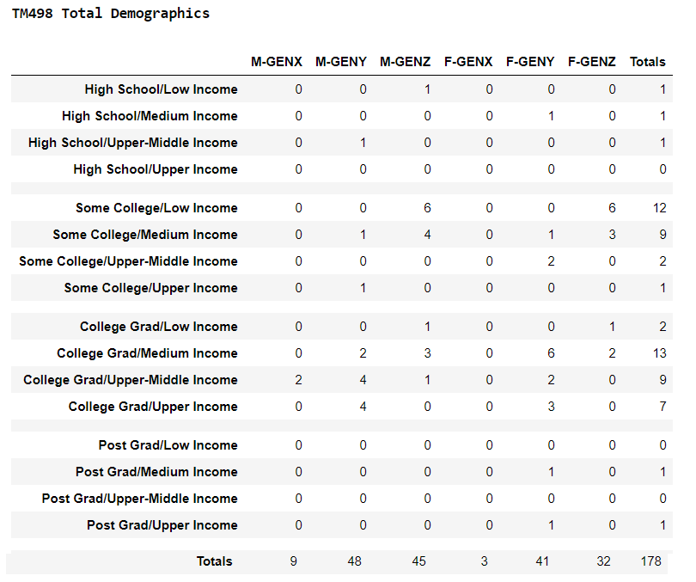
TM498 Demographics
The table to the left shows all Customers (178) grouped by sex (M = male, F = Female) and Age (Gen Z = 18-25, Gen Y = 26-40, Gen X = 41-50). They customers are broken into groups based on Education and Income.
The purpose of this table is to identify trends based on age, sex, education and income.
There does not appear to be a stand-alone group within
this data table. Data points of 3 or greater are adjacent
to other data points and can be grouped.
Male Gen Yers can be grouped by college grads; Male
Gen Zers can be grouped by some college education
and college grads, respectively. Gen Y, females can be
grouped by college grads and Gen Z, females can be
grouped by some college education.
Gen Z and Gen Y, college grads, can be grouped together
regardless of gender. So too can Gen Z and Gen Y,
medium and low-income individuals who have some
college education.

Slide 38
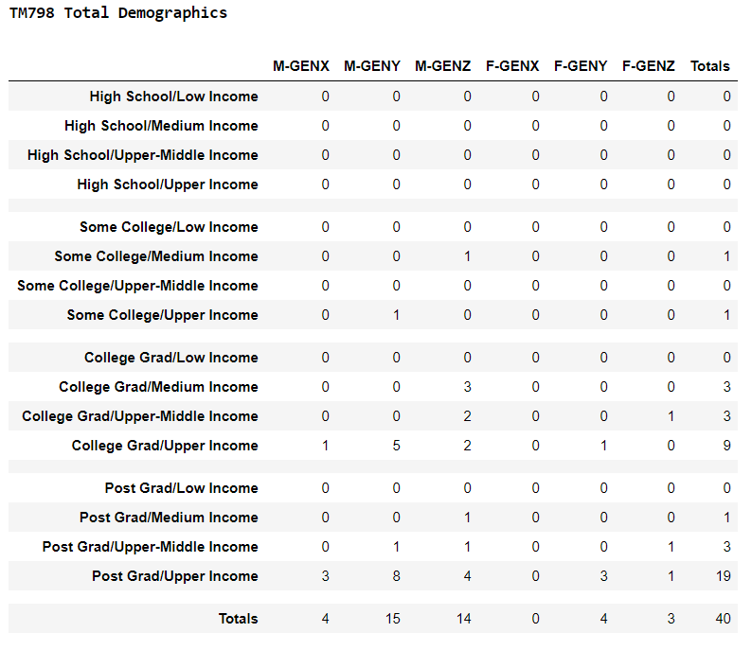
TM798 Demographics
The table to the left shows all Customers who purchased the TM798 from the total sales sample (n = 180).
There is a relatively high number of Male, Gen Y
customers with high incomes and college degrees who
purchased the TM798
Male, Gen Z customers with college or post-graduate
degrees tend to purchase the TM798 as well. As do
Female, Gen Z customers with post-grad degrees.
In general, post-graduates with high incomes tend to
purchase the TM798, with the only exception Female,
Gen Xers with post-grad degrees.

Slide 39
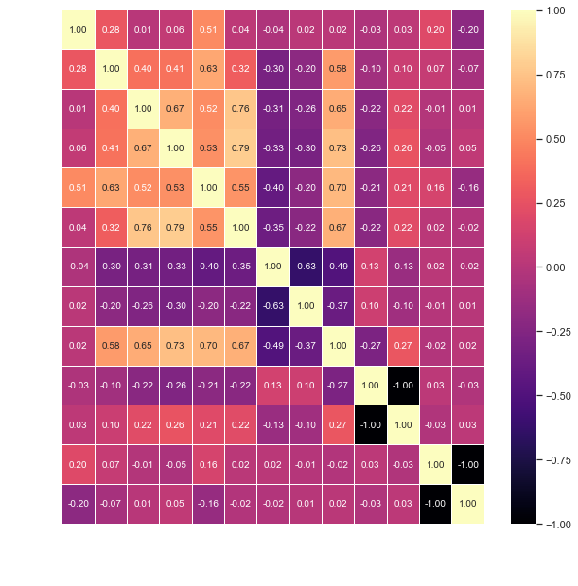
Identifying Key Variables
Age
Age is only moderately correlated with income, and none of the 3 product types, however, age is one of the easiest identifiable characteristic of potential customers.
Education
Education levels are positively correlated with Income and can help predict which brand of treadmill a particular customer is likely to purchase.
Income
Linked to both Age and Education, Income is one of the biggest indicators of which brand a customer is likely to select

Slide 40
Identifying Key Variables
Usage
Usage is a great indicator of brand preference:
as usage goes up, customers are more willing
to invest in the higher quality machines.
Fitness
Fitness is strongly linked to Usage, and as such, fitter individuals are more likely to use their treadmills more often and thus more likely to invest in higher quality.
Miles
Miles are strongly linked to both Usage and Fitness, as one might expect. As the miles logged goes up, customers want to invest in better quality equipment.

Slide 41
Secondary Variables
Gender
Gender has no moderate or strong correlations with other variables. Males are slightly more likely to purchase the higher end brands (weak correlation). They are also slightly more likely to be fitter, have higher usage and log more miles than females. While on its own, gender is not a good indicator of brand preference, we know males and females have different behavioural patterns which may be more evident once broken into smaller demographic groups, such as gender + age or gender + income. As such, gender should only be considered in conjunction with other variables.
Marital Status
This variable seems to have no moderate or strong correlations (positive or negative) with any other
variable. Although it is weakly correlated with age
(as one ages, (s)he is more likely to be partnered),
it will not be used as a predictor of product preference.

Slide 42
04
Applications

Slide 43
Mapping Customers by Products
TM195 (n= 80)
TM498 (n = 60)
TM798 (n = 40)
Target: 80%
Gen Y, Some College & College Grads
Gen Z, Some College & College Grads
Gen Z, High School, Low Income
Gen Y, College Grads
Gen-Z, Some College, Medium to Low Income
Gen Z, College Grads
Post-Grads
Gen Z, College Grads
Gen Y, College Grad, Upper Income
46.3%
35.0%
47.5%
31.6%
20.0%
30.0%
5.0%
13.3%
12.5%

Slide 44
Mapping Customers by Products
Target: >90%
93.8%
Overall Map Coverage:
Customer Profiles (n = 178):
Examine cross-generational trends
Study how gender may affect product choices within age demographics
Explore how income and education affects buying decisions
Consider how usage, fitness and miles may influence product selection.
The Influencer (n = 10)
The Graduate (n = 12)
The Self-Starter (n = 17)
The Explorer (n = 5)
The Connoisseur (n = 11)
The Builder (n = 18)
The Investor (n = 3)
The Smooth-Sailor (n = 6)
The Doctor (n = 8)
The Professor (n = 19)
The Utilizer (n = 35)
The Impulse-Buyer (n = 23)

Slide 45
Generational Buckets: Gen Z
The Influencer
The Self-Starter
The Graduate
The Explorer
Male, College Grad, Medium to Upper Income
Male, Some College, Medium to Low Income
Low Income, College Graduates
Male, High School Education, Low Income

Slide 46
Generational Buckets: Gen X / Y
The Connoisseur
The Investor
The Builder
The Smooth-Sailor
Male, Gen Y, College Grad, High Income
Gen X, Female, College Grad, Upper/Middle to Upper Income
Gen Y, Some College/College Grads, Low to Upper/Middle Incomes
Gen X, Male, College Grad, Upper/Middle to Upper Income

Slide 47
Cross-Generational Buckets
The Doctor
The Utilizer
The Professor
The Impulse Buyer
Female, Gen Y & Z, Post-Grad, Middle to High Income
Female, Gen Y & Z, Some College/College Grad, All Incomes
Gen X, Y & Z, Males, Post-Grad, Upper/Middle+ Incomes
Gen Y & Z, Males & Females, Some College/College Grad, Medium to Upper/Middle Incomes

Slide 48
Gen Z
Ages 18 to 25

Slide 49

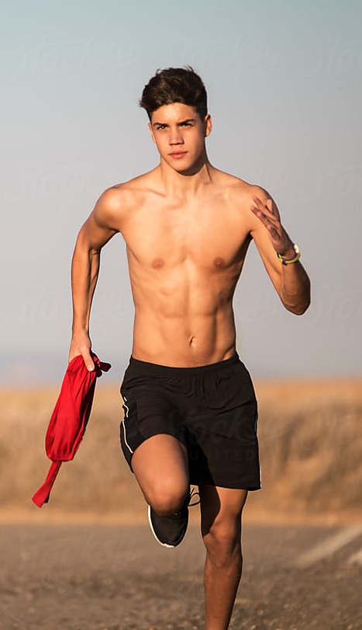
Education
The Influencer
GENDER
AGE
Marital Status
Women
Partnered
Men
Single
Income
x̅ = 23.9
x̅ = $53,252
n =10

Slide 50
The Influencer
LIFESTYLE
These young men have recently graduated college, landed their first job and anxiously want to spend their first pay cheque! The Influencer is almost twice as likely to buy the highest-end model, the TM798 as he is likely to buy the mid-model, TM498 and there is no way he will be caught dead with the TM195! He is much more interested in the higher-end brands in order to impress his friends!
The Influencer has the highest average income amongst Gen Z categories, at x̅ = $53,252 and he is not afraid to spend it. Wealth is not the only thing this young man likes to show off, either. Considering his high average usage rate (x̅ = 3.60), average fitness level (x̅ = 4.20) and average miles (x̅ = 112.20), it is clear that the Show-Off loves to flaunt his fit physique just as much as his money!
TM798
Recommendation:

Slide 51
The Graduate
Education
GENDER
Marital Status
Women
Partnered
Men
Single
AGE
Income
x̅ = 23.3
x̅ = $39,985
n = 12

Slide 52
The Graduate
LIFESTYLE
The Graduate has just completed his or her college/university degree and is looking forward to entering the working world. Big changes are on the horizon for these young individuals, who may have sacrificed time at the gym for higher marks. Of the four Gen Z categories, the Graduates have the second lowest average fitness (x̅ = 2.67) and expected miles (x̅ = 79,42) but the second highest expected usage (x̅ = 3.25).
The Graduate is just as likely to be partnered as (s)he is likely to be single, but the one thing this group has in common besides being highly educated, is their low average income. No one in this group is making more than $44,000 per year, which places the group in the lowest of the four income quadrilles.
As a group, the Graduates are more likely to purchase the TM195 than any other product. Less than 20% of Graduates splurge on the TM498 model and it seems like none can justify the hefty price tag of the TM798.
Males
Females
TM195
Recommendation:

Slide 53

The Self-Starter
Education
GENDER
Marital Status
Women
Partnered
Men
Single
AGE
Income
x̅ = 22.2
x̅ = $39,781
n = 17

Slide 54
The Self-Starter
LIFESTYLE
The Self-Starter is nothing if not ambitious. This group of young men have spent an average of 14.12 years in school and are anxious to start their careers. Armed with a two-year college diploma or some university education, the Self-Starters do not command high salaries, with an average income of just $39,781. But as the second youngest age group (x̅ = 22.2), this will probably change quickly!
Self-Starters are the second fittest of the Gen Z group (x̅ = 3.24) and while their planned usage is the lowest (x̅ = 3.06) for their age group, they plan to run more miles than the Graduates and the Explorers (x̅ = 95.71).
One defining feature of this group is they are not afraid to spend the little money they have. They are actually more likely to purchase a higher end model than the TM195 (7) with the TMN498 as their go-to favourite (9).
TM498
Recommendation:

Slide 55
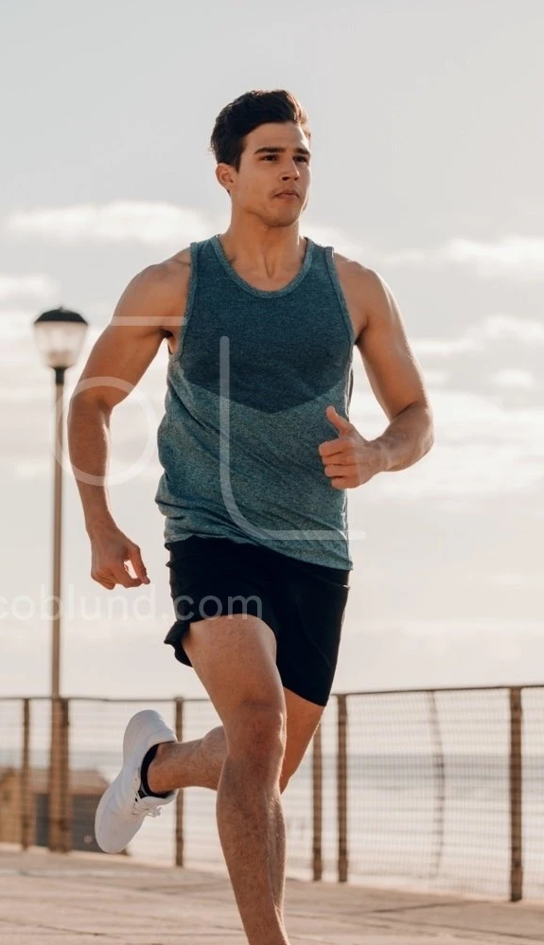
Education
The Explorer
GENDER
AGE
Marital Status
Women
Partnered
Men
Single
Income
x̅ = 21
x̅ = $35,247
n =5
CAUTION: small sample size

Slide 56
The Explorer
LIFESTYLE
The Explorer represents the youngest of all categories of customers, with an average age of just 21.0 years. These young men have spent an average of just 12.6 years in school and seem to be at a crossroads in their lives. They value their freedom and may just be taking some time off before post-secondary education. A gap year or two will allow them to travel the world or experience the great outdoors. To finance their lifestyle, they may be required to carry two jobs for part of the year. Due to these time constraints, the Explorer shows the lowest average usage (x̅ = 3.00), fitness (x̅ = 2.40) and expected miles (x̅ = 63.40) of the Gen Zers.
These low numbers, coupled with their low average salaries (x̅ = $35,247) suggests that the TM195 is the right fit. Sales of the product amount to 80% of total sales for this small sample group.
TM195
Recommendation:

Slide 57
Gen Y
Ages 26 to 40

Slide 58

The Connoisseur
Education
GENDER
Marital Status
Women
Partnered
Men
Single
AGE
Income
x̅ = 34.2
x̅ = $71,445
n = 11

Slide 59
The Connoisseur
LIFESTYLE
The Connoisseur appreciates the finer things in life and the TM798 is no exception! This GenY male is a college graduate who makes the second highest average income (x̅ = $71,444), following only the Professor. Comfort is a must when you are logging as many miles as the Connoisseur, who leads all demographics with expected miles of 156.45.
The Connoisseur needs a machine that will keep up to his heavy usage. In addition to ranking first with expected miles, the Connoisseur also ranks second (tie) and third in average usage (x̅ = 4.00) and fitness (x̅ = 4.00), respectively.
The Connoisseur tends to choose the higher end TM798 almost half of the time (5/11), with the TM498 model coming in a close second (4/11). Like the Utilizer, the Connoisseur is much more likely to invest in the TM798 model when average usage, fitness and miles go up. He is also much more likely to purchase the TM798 as his average income goes up:
TM498
TM798
TM798
Recommendation:

Slide 60

The Builder
Education
GENDER
Marital Status
Women
Partnered
Men
Single
AGE
Income
x̅ = 29.8
x̅ = $47,691
n = 18

Slide 61
The Builder
LIFESTYLE
The Gen Y Builder know the value of money. They are working hard towards their futures and this may mean paying off student debt, purchasing a new home, or starting a family. The Builder has attended a post-secondary educational institution and has learned how to budget efficiently.
As a consumer group, they almost always choose the lower end TM195, which helps them successfully manage their finances. It is very difficult, but not impossible, to persuade these individuals to go outside their budget and invest in the higher-end model TM498, but it would take a miracle to convince them to go home with a TM798! These trends hold true across genders.
The Builder plans on using their treadmills about 3 times per week (x̅ = 2.89) their average fitness level is about 3 (x̅ = 2.89), and they average almost 80 miles (x̅ = 78.78).
TM195
Recommendation:

Slide 62
Gen X
Ages 41 to 50

Slide 63

Education
The Investor
GENDER
AGE
Marital Status
Women
Partnered
Men
Single
Income
x̅ = 46.7
x̅ = $61,109
n = 3 CAUTION: small sample size

Slide 64
The Investor
LIFESTYLE
This female GenXer is a college graduate who makes a very healthy income. She belongs to the Upper-Middle- or Upper-class but she is not willing to spend her hard-earned money on superfluous items. Retirement is around the corner and she is too busy investing in herself to throw money away on gadgets. These savvy women only purchase the TM195 and cannot be swayed by the charming sales-person attempting to upsell features which they will not use.
The Investor has a lower-than-average in terms of fitness (x̅ = 3.00 ), and they are the second lowest consumer group with regards to usage (x̅ = 3.00). The target milage for these women is the lowest of any demographic (x̅ = 62.60). The bottom line is do not try to sell these intelligent women a product they do not need; the entry model TM195 will meet their fitness goals!
TM195
Recommendation:

Slide 65

The Smooth-Sailor
Education
GENDER
Marital Status
Women
Partnered
Men
Single
AGE
Income
x̅ = 44.8
x̅ = $61,386
n = 6
CAUTION: small sample size

Slide 66
The Smooth-Sailor
LIFESTYLE
The Smooth-Sailor’s hardest-working years are behind him and he is looking forward to retirement. This does not mean he is resting on his laurels, however. The Smooth-Sailor falls just below the median in usage (x̅ = 3.33), fitness (x̅ = 3.17) and expected miles (x̅ = 88.17) across all demographics. Not bad, considering the average age of this group, at 44.8 years, is second only to the Investors.
The Smooth-Sailor, despite enjoying the third highest average income (x̅ = $61,386), knows the value of a hard-earned dollar, and desires value for his money. Despite the small sample size (n = 6), 40% of these men will purchase the higher end TM498 without much regard to usage, fitness or miles run. Be careful, however, due to the small sample size, one member of this group can be considered an outlier, making almost double the salary of the other men in this group ($90,886 vs $55.486*) as well as higher usage, fitness and expect miles numbers. Naturally, this gentleman purchased the TM798, and with more data, could easily become a breakout demographic of his own. Overall, the Smooth-Sailor can be characterized by his college degree and his upper-middle class income. He is also 80%+ likely to be partnered.
*Calculated as the average incomes of the 5 remailing Smooth-Sailors
TM498
Recommendation:

Slide 67
Cross Gen
Possess common
characteristics other than age

Slide 68

The Doctor
Education
GENDER
Marital Status
Women
Partnered
Men
Single
AGE
Income
x̅ = 29.3
x̅ = $69,039
n = 8
CAUTION: small sample size

Slide 69
The Doctor
LIFESTYLE
The Doctor is a force to be reckoned with! With an average age of just 29.3 years, this Gen Z/Y has attended school for an average of 18.38 years, the second most across all demographics. The Doctor’s usage is tied for second highest (x̅ = 4.00) and expected miles is third most (x̅ = 120.00).
Despite commanding the second highest average income (x̅ = $69,039), she is going to make up her own mind regarding which model best suits her own needs. While the Doctor is almost twice as likely to buy the top model, TM798 (5/8), the model she selects is directly linked to her usage, fitness and miles. Usage (x̅ = 4.80 vs x̅ = 2.67) and fitness (x̅ = 4.40 vs x̅ = 2.67) is nearly double for purchasers of the TM798, and expected miles nearly triples (x̅ = 156.00 vs x̅ = 60.00). Women in this group belonging to Gen Z have slightly higher usage, fitness and expected miles values as well.
Gen Z
Gen Y
TM798
Recommendation:

Slide 70

Education
The Professor
GENDER
AGE
Marital Status
Women
Partnered
Men
Single
Income
x̅ = $80,959
n =19

Slide 71
The Professor
LIFESTYLE
The Professor is easily recognized as the group with the highest average education (x̅ = 18.42). Or is it the highest average yearly income (x̅ = $80,859)? Wait, it must be their absurdly high fitness level (x̅ = 4.47), ranked #1 across all demographics! Their hard work also makes them tops when it comes to usage (x̅ = 4.79) and the second highest in expected miles (x̅ = 153.95).
Despite their young age (x̅ = 31.0), they are overwhelmingly likely to already be partnered. With that high average income, they cannot be bothered to hangle with price; they just want the very best! The TM798 is the product for this group, and it is very rare that they will even consider a lower-end product. With a 95% TM798 buying rate (18/19), you might as well start preparing the paperwork. The Professor takes the guess work out of product marketing.
Gen Z
Gen Y
TM798
Gen X
Recommendation:

Slide 72

The Utilizer
Education
GENDER
Marital Status
Women
Partnered
Men
Single
AGE
Income
x̅ = $47,395
n = 35

Slide 73
The Utilizer
LIFESTYLE
The Utilizer can be broken down into two sub-groups: the Gen Y college grad and the Gen Z with some college experience. For both of these groups of women, their motto in life is, “You get out what you put in”. The Gen Y women primarily command salaries in the medium through upper income ranges while the Gen Z women are still in the lowest income bracket. Both groups, however, show they are willing to spend more money provided it gives them more utility. 40% of the Gen Y women and 60% of the Gen Z women in this category have purchased the lower end, TM195 model while 55% and 40% have opted for the more expensive TM498 model, respectively.
Usage and miles seem to be the determining factors with these women: TM195 usage, x̅ = 2.90 (Gen Y) and 2.78 (GenZ), fitness x̅ = 2.80 (Gen Y) and 2.78 (GenZ), and miles x̅ = 76.30 (Gen Y) and 73.22 (GenZ). For TM498, usage x̅ = 3.27 (Gen Y) and 3.17 (GenZ), fitness x̅ = 3.00 (Gen Y) and 3.00 (GenZ) and miles x̅ = 86.81 (Gen Y) and 107.83 (GenZ). To really drive home this point, the one customer in this category who splurged on the TM798 expects to use her machine 6 times a week and log 280 miles!
Gen Z
Gen Y
TM498
Recommendation:

Slide 74

The Impulse-Buyer
Education
GENDER
Marital Status
Women
Partnered
Men
Single
AGE
Income
x̅ = $49,830
n = 23

Slide 75
The Impulse-Buyer
LIFESTYLE
The Impulse-Buyer is not stupid, (s)he just does not have time to comparative shop! With an average education level of 15.65 years, the Impulse-Buyer knows exactly what (s)he needs and just goes out and gets it. The purchasing partners of this group is almost perfectly split between the TM195 (12) and the TM498(11). With only the sixth highest average income amongst the twelve groups (x̅ = $49,830), the TM798 (0) may be slightly out of reach.
The Impulse-Buyer falls near the middle of the pack with average usage (x̅ = 3.30), average fitness (x̅ = 3.09), and average expected miles (x̅ = 93.43). The type of model they select is not dependent on their income, their age, or even, like the Utilizer, based on usage, fitness or miles. It almost appears as if they purchase the first model they see! Best to present them with the TM498 first and hope for a quick sale!
Gen Z
Gen Y
TM498
Recommendation:

Slide 76
05
Data

Slide 77
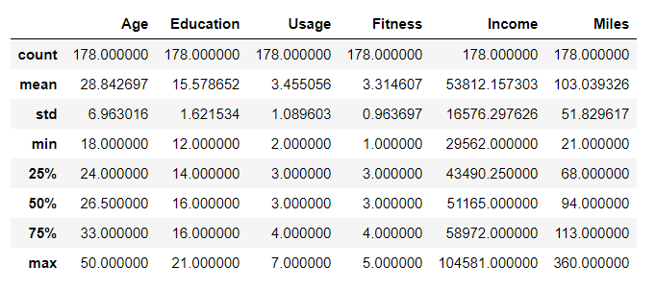
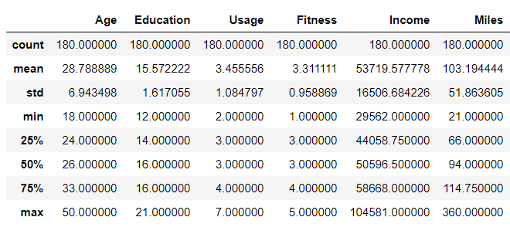
Data Table Summaries
Product Profile
Customer Profile

Slide 78
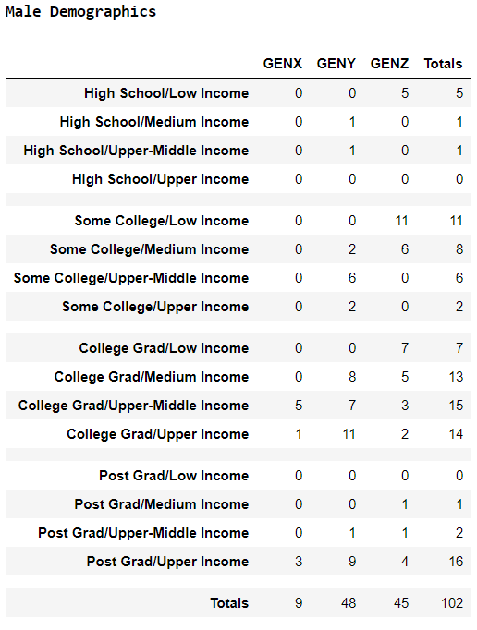
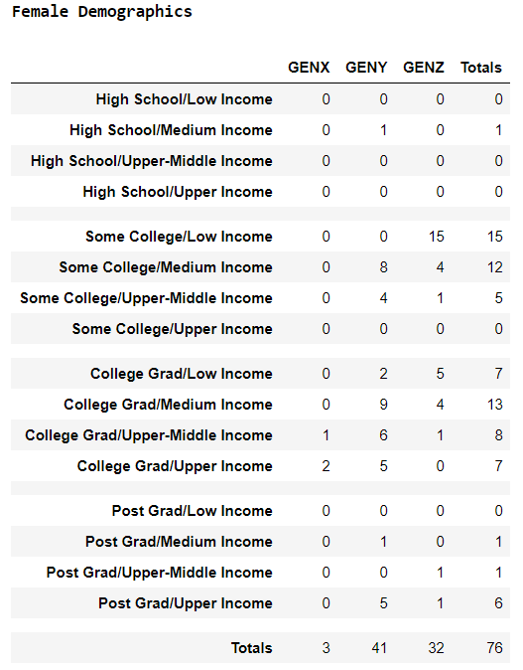
Data Table Summaries

Slide 79
06
Conclusions

Slide 80

Relevance of Study
Sales representatives can use these findings to help determine the best possible product for an individual based on a few simple questions. This can help ensure customer satisfaction as well as enhance company revenues by reducing returns and upselling products when appropriate.

Slide 81
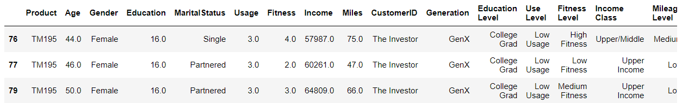
Applying the Findings
Click Here To Check!
Customer Profile Example: The Investor
The ultimate goal of the study is to be able to sort and filter by CustomerID, grouping individuals
by profile buckets, which we now have the ability to do. Then, referencing the Customer Profiles, we
can predict with relative certainty which product best matches the customer’s lifestyle. In this case, an
Individual identified under ‘The Investor’ would probably choose the TM195.

Slide 82
Limitations
This study has an overall small sample size of just 178 distinct customers and 180 distinct sales. While these numbers seem adequate, there is not uniform distribution across all demographics. As such, groups like the 41-50 olds are underrepresented. Customer Profiles with a small ‘n’ may be inaccurate, such as The Doctors (n=3).

Slide 83
Going Forward
As sales continue, records should be kept of customer attributes so that they can be added to the study. By growing all Customer Profile groups, we can finely tune the Profiles based on buying behaviour. New Profiles can be added as necessary.

Slide 84
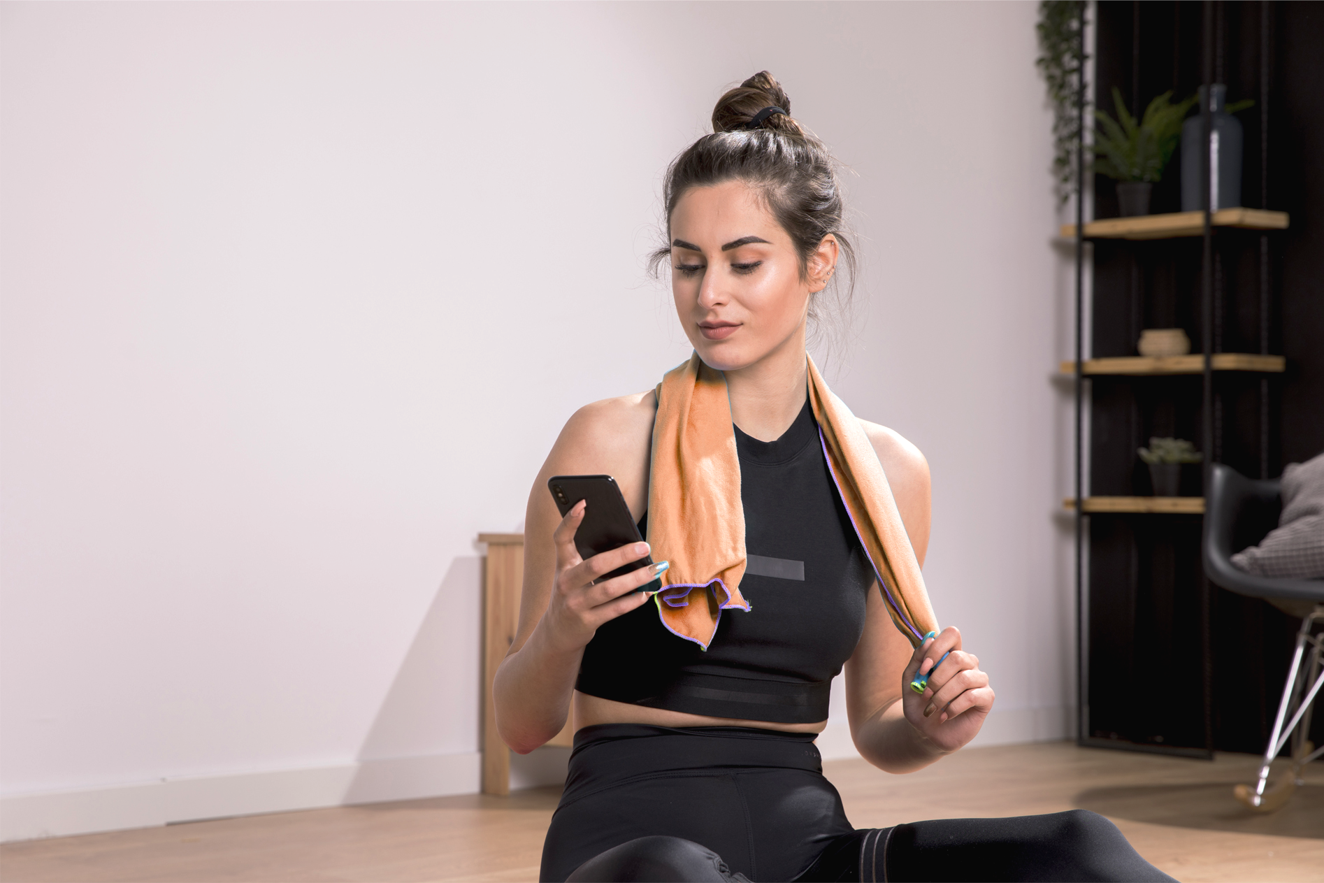
New Opportunities
Gen X and Baby Boomers
Currently there are 12 sales to individuals aged 41 to 50. Gen X extends to 57 years of age and Boomers, the largest single demographic in North America, range from 58 to 75+. Marketing a product where safety, comfort and ease-of-use are priorities could be a top seller. Marketing to people who live in dangerous areas or prone to inclimate weather could convince them of the comparative safety of at-home exercise equipment. These
age groups have lots of leisure time
and money to spare!

Slide 85
THANK YOU!
PLEASE KEEP THIS SLIDE FOR ATTRIBUTION.

